Slide 1

Trailer

Slide 2


We are #1
Project Hope

Slide 3
Our game
Why is it fun?
Why is it good for the campaign?
Why is it on mobile? (target audience)

Slide 4
Play the game

Slide 5

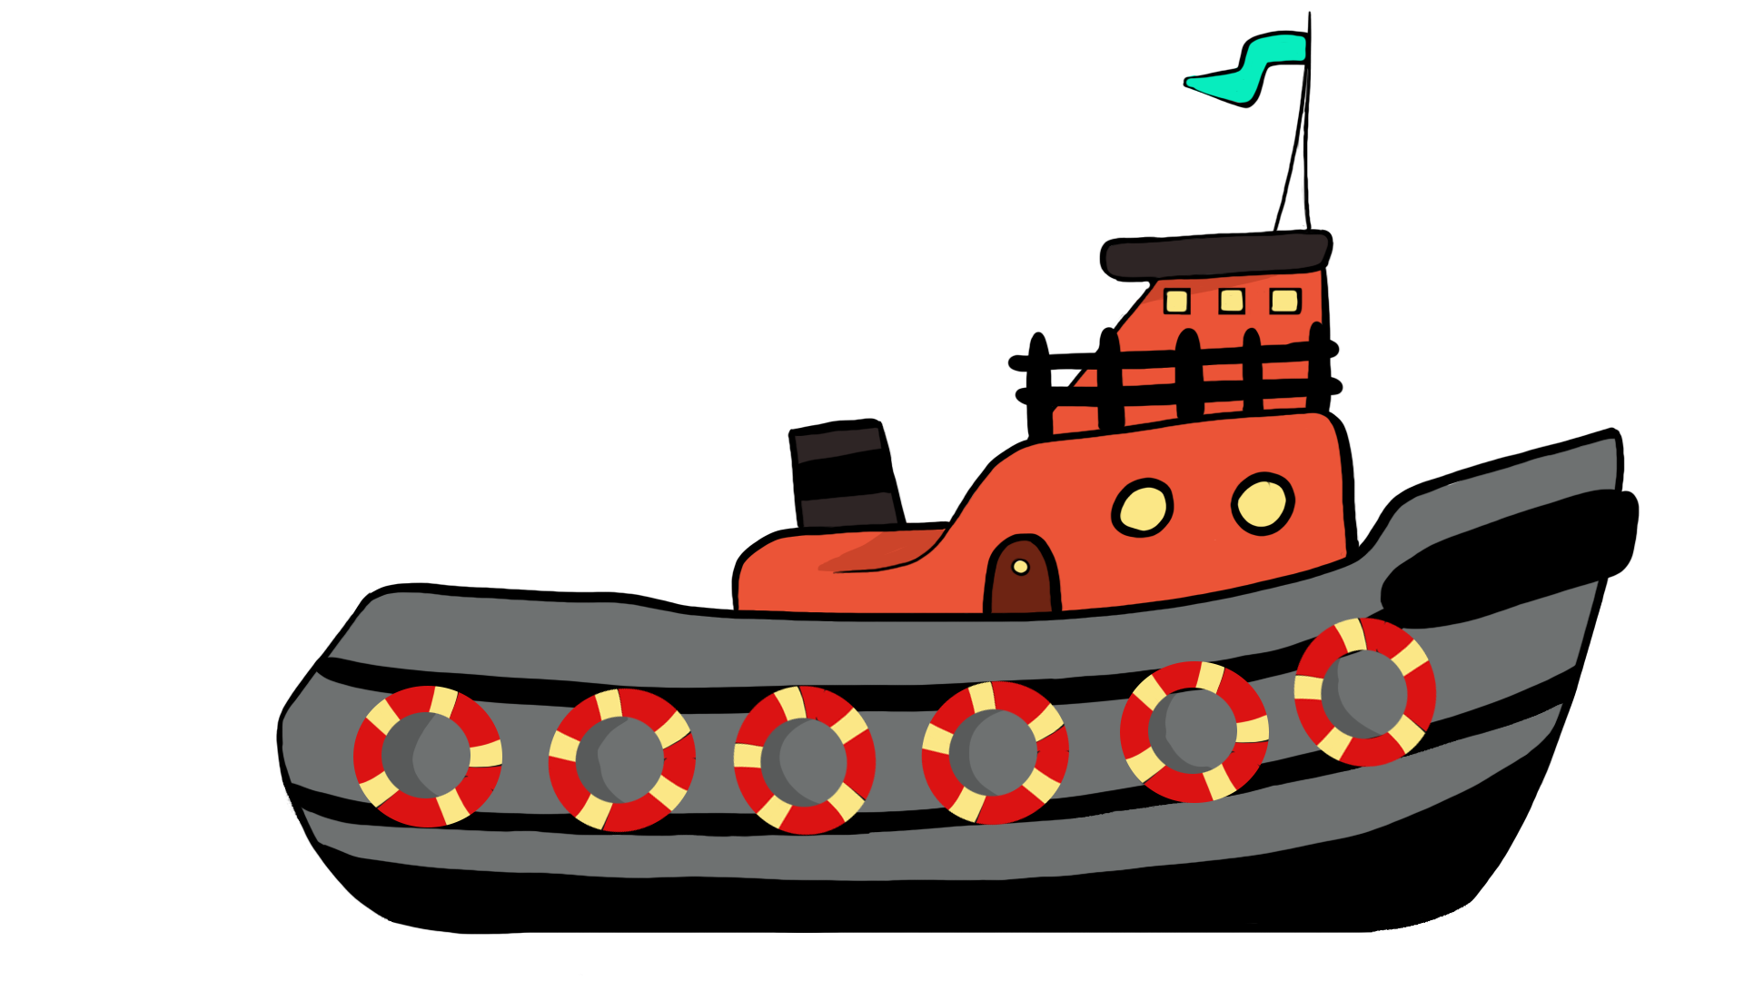
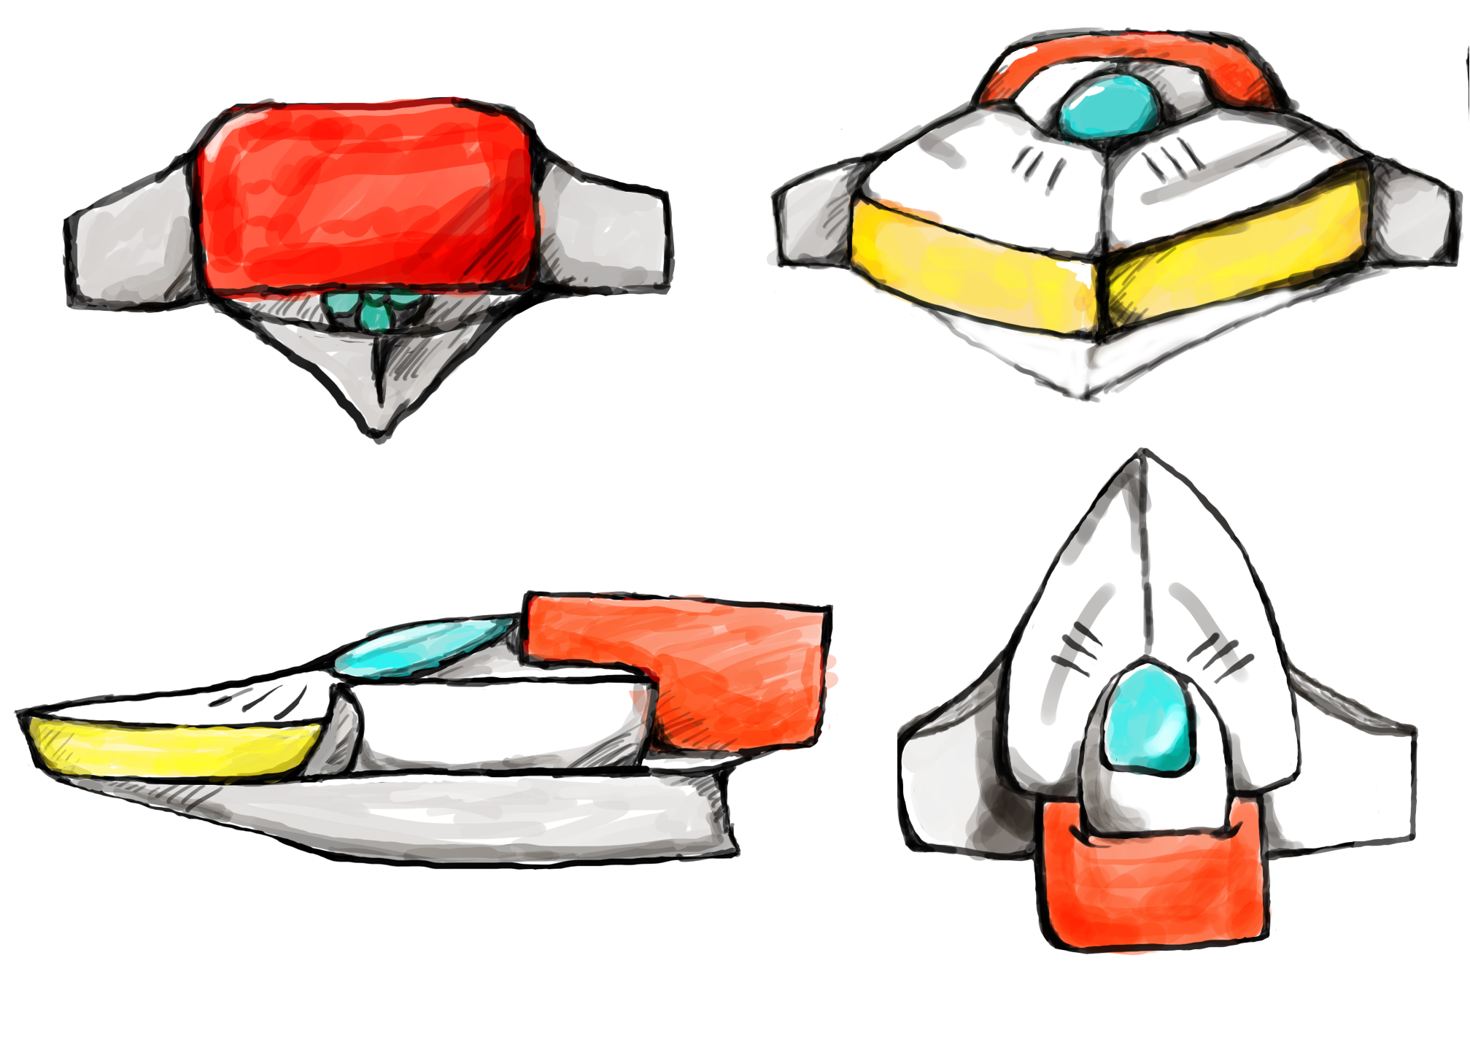
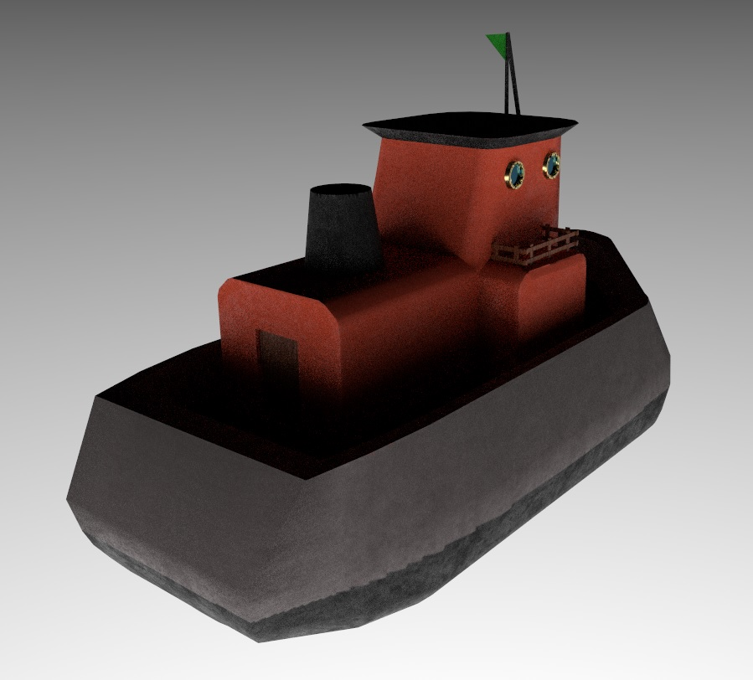
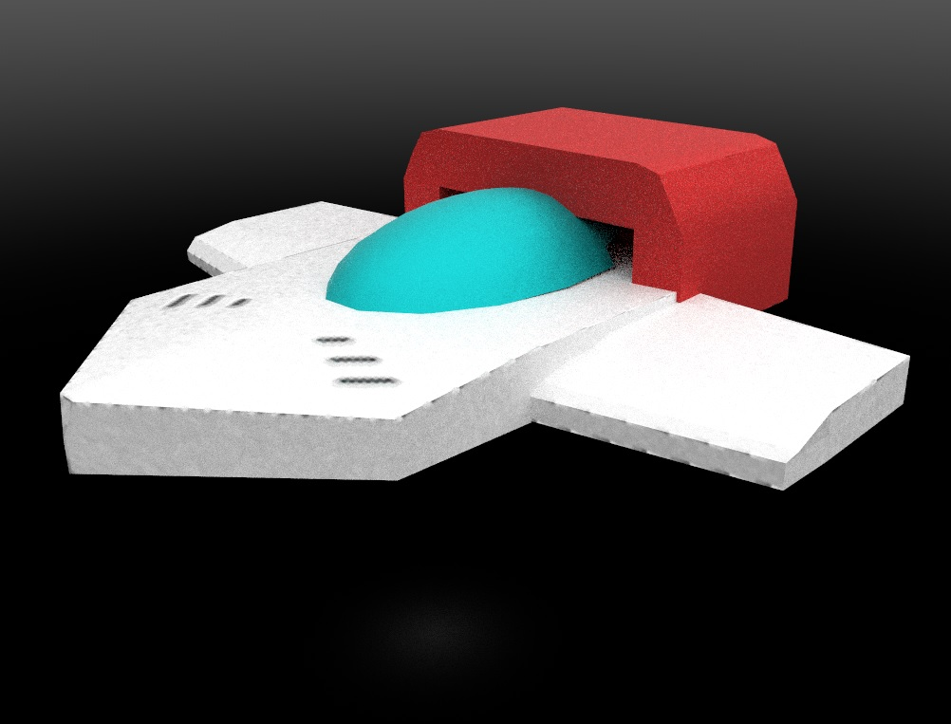
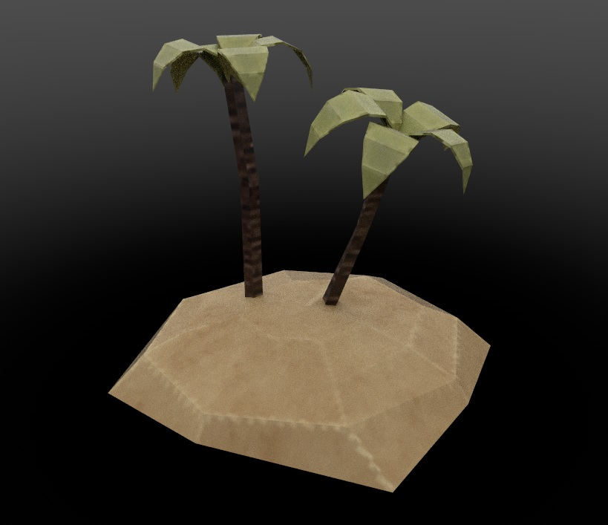
Concept and model

Slide 6
Assets 3D

Slide 7
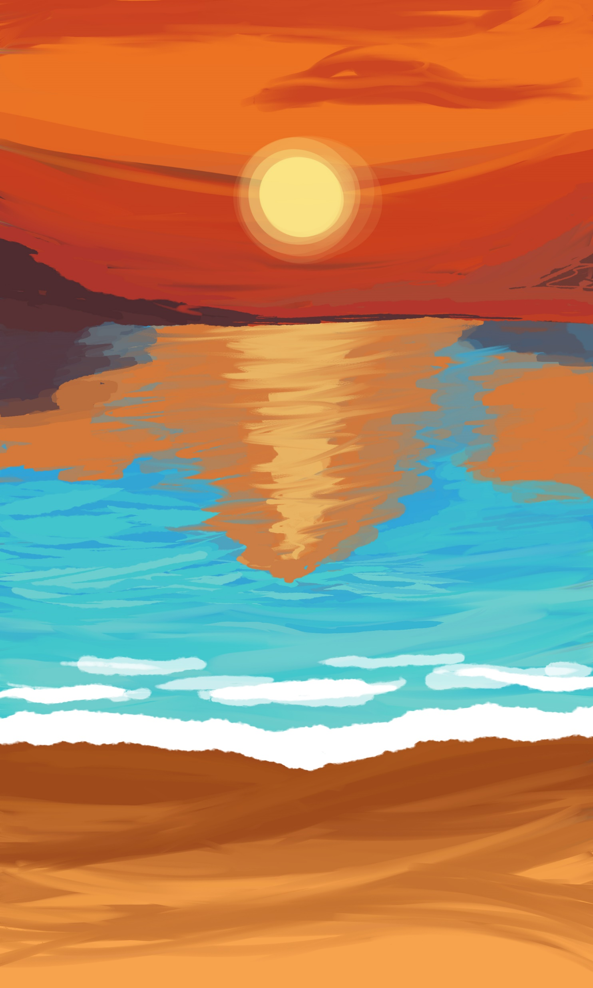



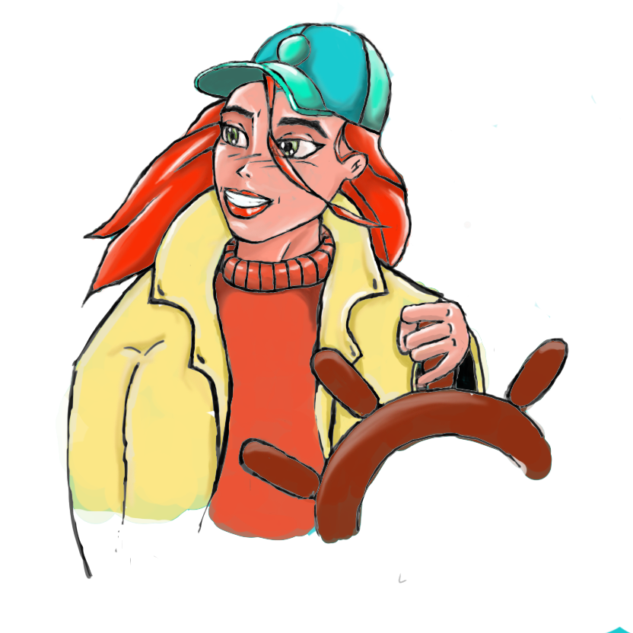












UI Assets

Slide 8

Music & sound effects
Crash
A different song per level
&
Over 20 different sound effects
Boat engine
Ocean

Slide 9
Rob Artist
Shaders
Particles
3D modeling
Project management

Slide 10
Humam Artist

Slide 11
Tamara Artist

Slide 12
Olivier Designer
Concepting
3D models
Texturing
Character design
Dialog text

Slide 13
Rick Designer
Research
Game design documentation
UI design
UI programming
Audio programmer
Testing

Slide 14
Glyn Programmer

Slide 15
Team reflection
Communication
Green card!

Slide 16
Thank you for listening!

